Slide 1

7th Grade Math
Unit 4, Lesson 2 Finding the Area of Trapezoids, Parallelograms, and Rhombi Volume 1, pg. 132

Slide 2


Benchmark
MA.7.GR.1.1
Apply formulas to find the areas of trapezoids, parallelograms, and rhombi.
volume 1, pg. 132

Slide 3
Integrated Mathematical Thinking and Reasoning Standards
MA.K12.MTR.1.1 Actively participate in effortful learning both individually and collectively.
MA.K12.MTR.5.1 Use patterns and structure to help understand and connect mathematical concepts.
MA.K12.MTR.7.1 Apply mathematics to real-world contexts.
volume 1, pg. 132

Slide 4

Learning Target
I can find the area of trapezoids, parallelograms, and rhombi.
volume 1, pg. 132

Slide 5

Warm-Up
volume 1, pg. 133

Slide 6
4.2.1 Warm-Up: A Day in the Life
Betsy McIver, a mechanical engineer, works in the Walt Disney Imagineering area and designs systems for the interactive attractions at the theme park. She mentions that her job can include creative left-brain thinking, as well as technical right-brain thinking. She says that to be successful at her job, it is important to understand math, design, and theatre. She also mentions that many disciplines, such as designers and architects, all work together to make everything possible in the entertainment engineering industry.
Describe a ride you saw that looked exciting and entertaining.
volume 1, pg. 133
Notes:
Video Link: https://algebranation.wistia.com/medias/fi4fidi5y8

Slide 7

Guided Practice
volume 1, pg. 133

Slide 8

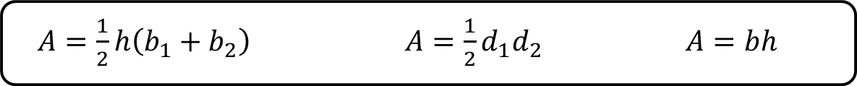
4.2.2 Guided Practice: Finding the Area of Parallelograms, Trapezoids, and Rhombi
Complete the table to match each type of quadrilateral with the formula to find its area.
$A=\frac{1}{2}h\left(b_{1}+b_{2}\right)$ $A=\frac{1}{2}d_{1}d_{2}$ $A=bh$
Quadrilateral | Formula for the Area
parallelogram
trapezoid
rhombus
volume 1, pg. 133

Slide 9
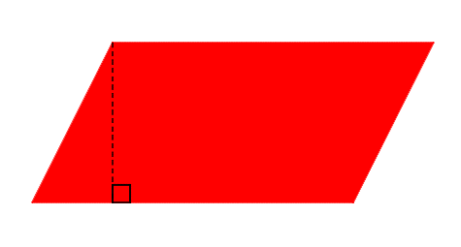
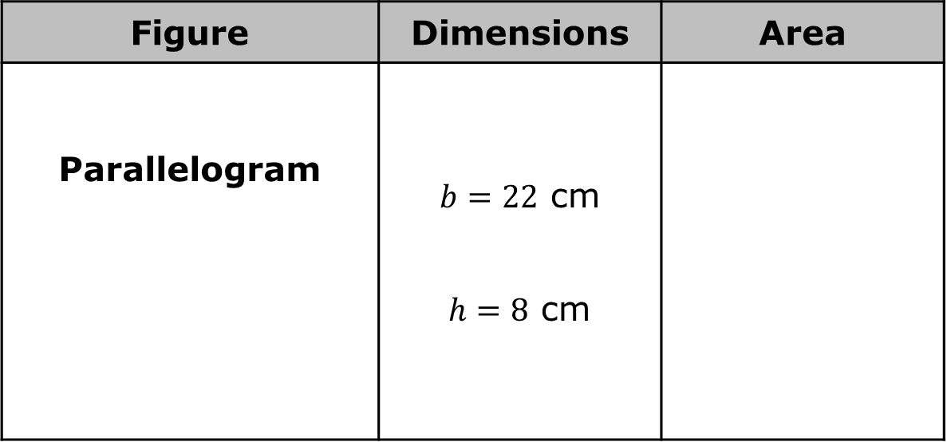
The dimensions of three quadrilaterals are given in the table. Label each figure shown with the given dimensions in centimeters (cm). Then, calculate the area of each figure using the appropriate formula. Show your work.
Figure | Dimensions | Area
Parallelogram | $b=22$ cm $h=8$ cm
volume 1, pg. 133

Slide 10
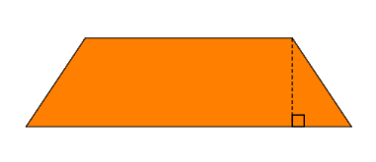
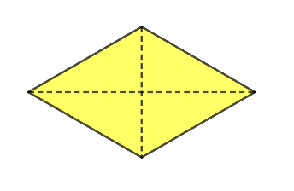
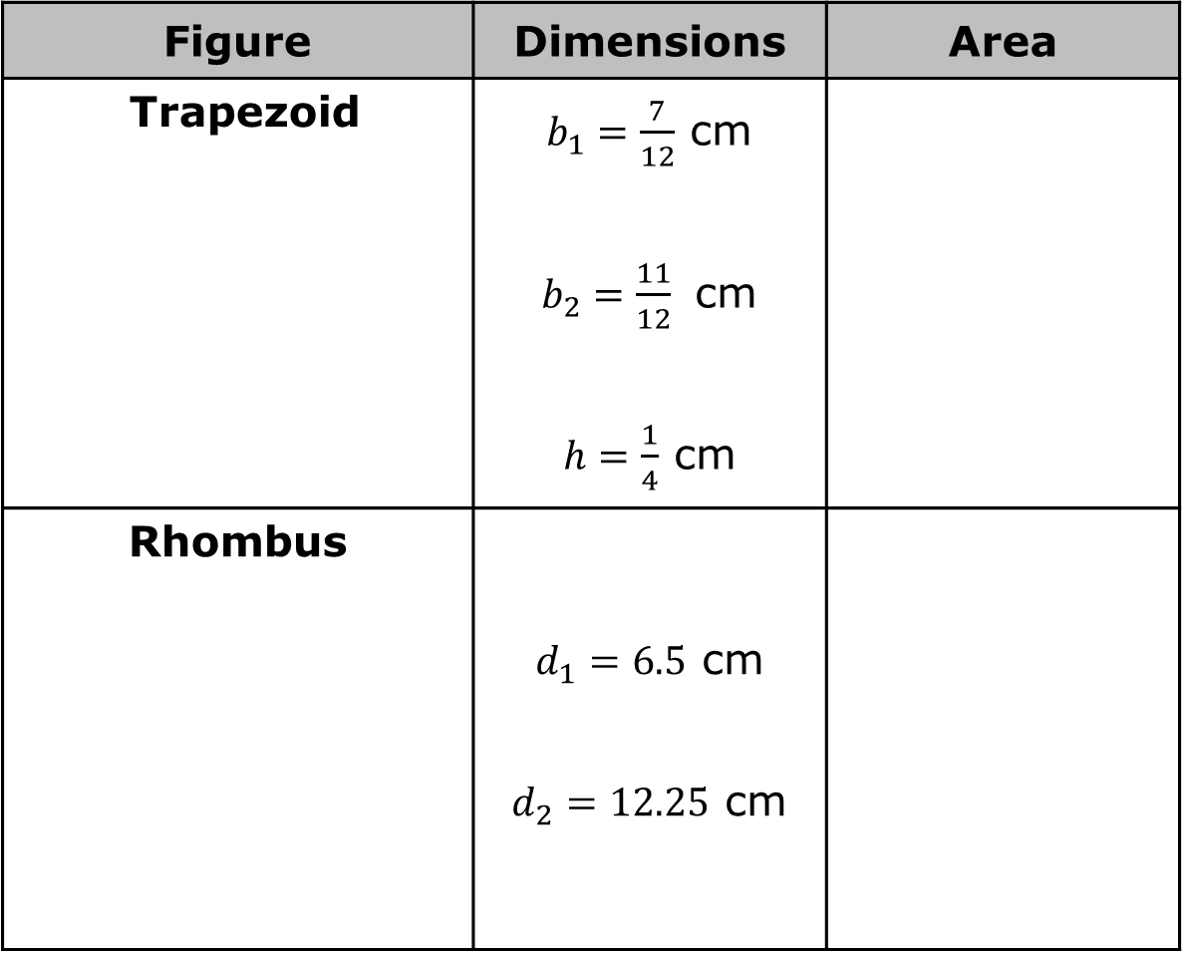
Figure | Dimensions | Area
Trapezoid | $b_{1}=\frac{7}{12}$ cm $b_{2}=\frac{11}{12}$ cm $h=\frac{1}{4}$ cm
Rhombus | $d_{1}=6.5$ cm $d_{2}=12.25$ cm
volume 1, pg. 134

Slide 11

Your Turn
volume 1, pg. 134

Slide 12
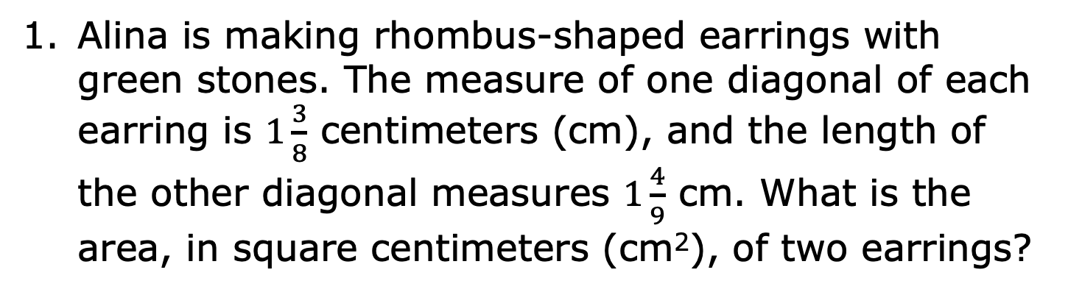
4.2.3 Your Turn!
Alina is making rhombus-shaped earrings with green stones. The measure of one diagonal of each earring is $1\frac{3}{8}$ centimeters (cm), and the length of the other diagonal measures $1\frac{4}{9}$ cm. What is the area, in square centimeters (cm²), of two earrings?
volume 1, pg. 134

Slide 13
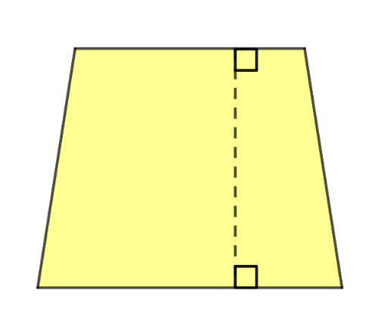



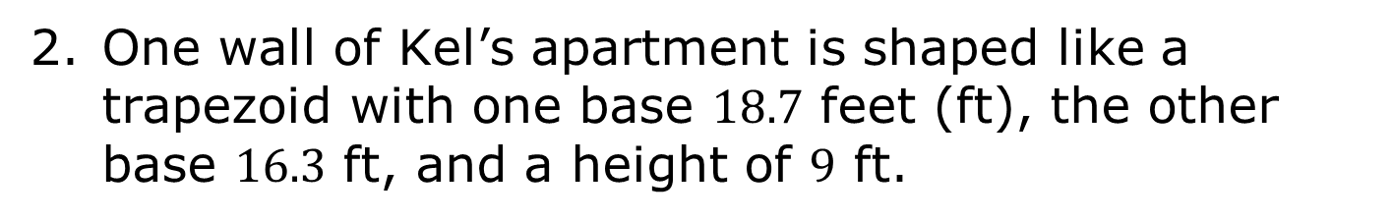
One wall of Kel’s apartment is shaped like a trapezoid with one base $18.7$ feet (ft), the other base $16.3$ ft, and a height of $9$ ft.
$16.3$ ft
$9$ ft
$18.7$ ft
Kel plans to paint this wall blue and needs to know how much paint to buy. What is the area of the wall Kel plans to paint?
volume 1, pg. 134

Slide 14
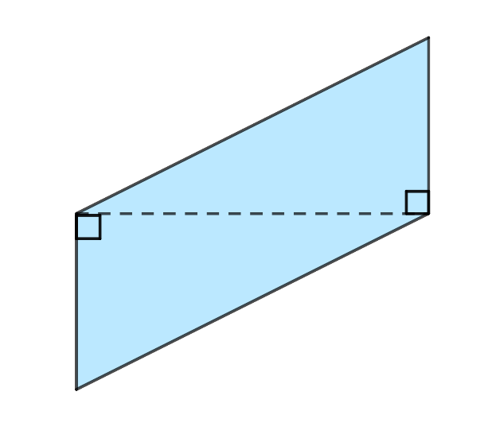
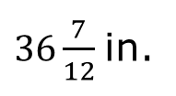
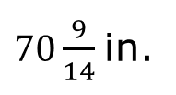
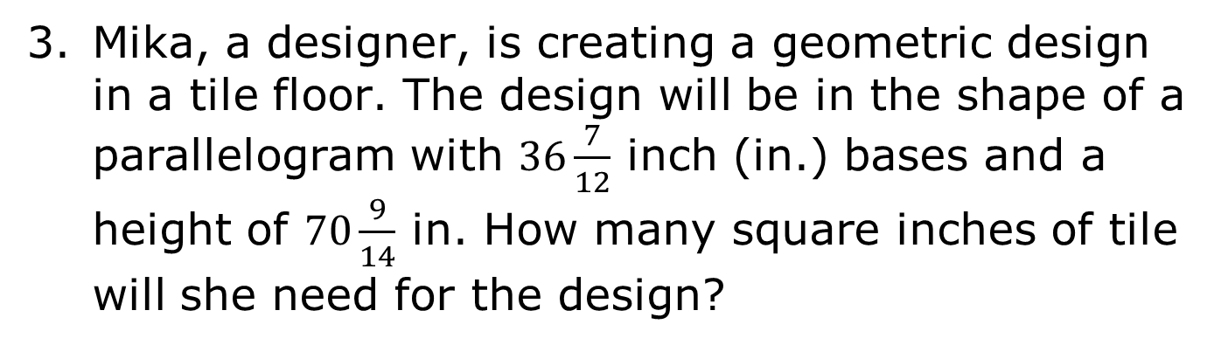
Mika, a designer, is creating a geometric design in a tile floor. The design will be in the shape of a parallelogram with $36\frac{7}{12}$ inch (in.) bases and a height of $70\frac{9}{14}$ in. How many square inches of tile will she need for the design?
$36\frac{7}{12}$ in.
$70\frac{9}{14}$ in.
volume 1, pg. 135

Slide 15
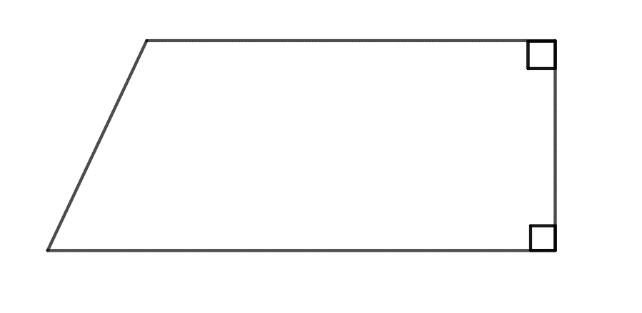



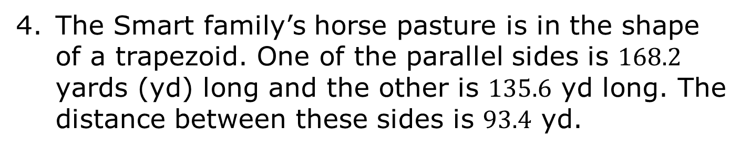
The Smart family’s horse pasture is in the shape of a trapezoid. One of the parallel sides is $168.2$ yards (yd) long and the other is $135.6$ yd long. The distance between these sides is $93.4$ yd.
$135.6$ yd
$93.4$ yd
$168.2$ yd
What is the area of the horse pasture?
volume 1, pg. 135

Slide 16
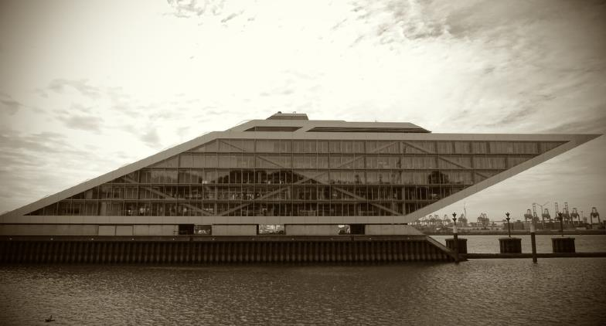
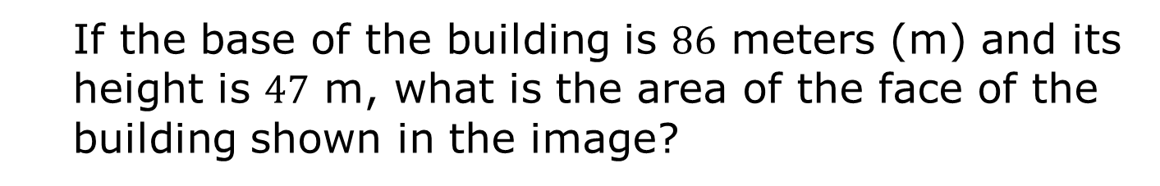
The Dockland Building in Hamburg, Germany is shaped like a parallelogram.
If the base of the building is $86$ meters (m) and its height is $47$ m, what is the area of the face of the building shown in the image?
volume 1, pg. 135

Slide 17

Wrap-Up
volume 1, pg. 136

Slide 18
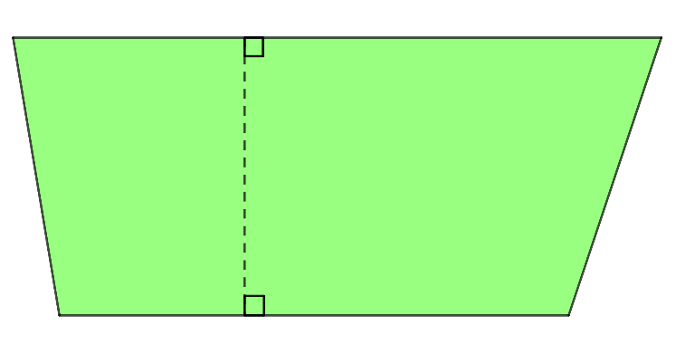



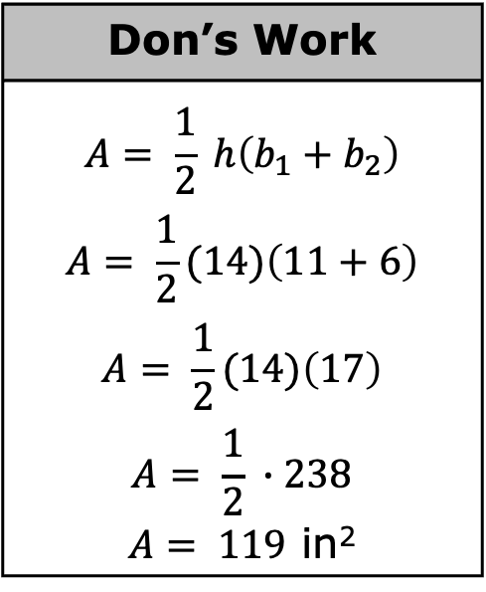
4.2.4 Wrap-Up: Ticket Out the Door
Don’s work for finding the area of the trapezoid is shown below.
Don’s Work
$$A= \frac{1}{2} h\left(b_{1}+b_{2}\right)$$ $$A= \frac{1}{2}(14)\left(11+6\right)$$ $$A= \frac{1}{2}(14)\left(17\right)$$ $$A= \frac{1}{2} ∙238$$ $A= 119$ in²
$14$ in.
$6$ in.
$11$ in.
volume 1, pg. 136

Slide 19
Write Don a note explaining what he did correctly and where he made an error.
What is the area of the trapezoid?
volume 1, pg. 136

